Slide 1


Slide 2


Let’s Create PowerBI Dashboard.
Where do I START?

Slide 3
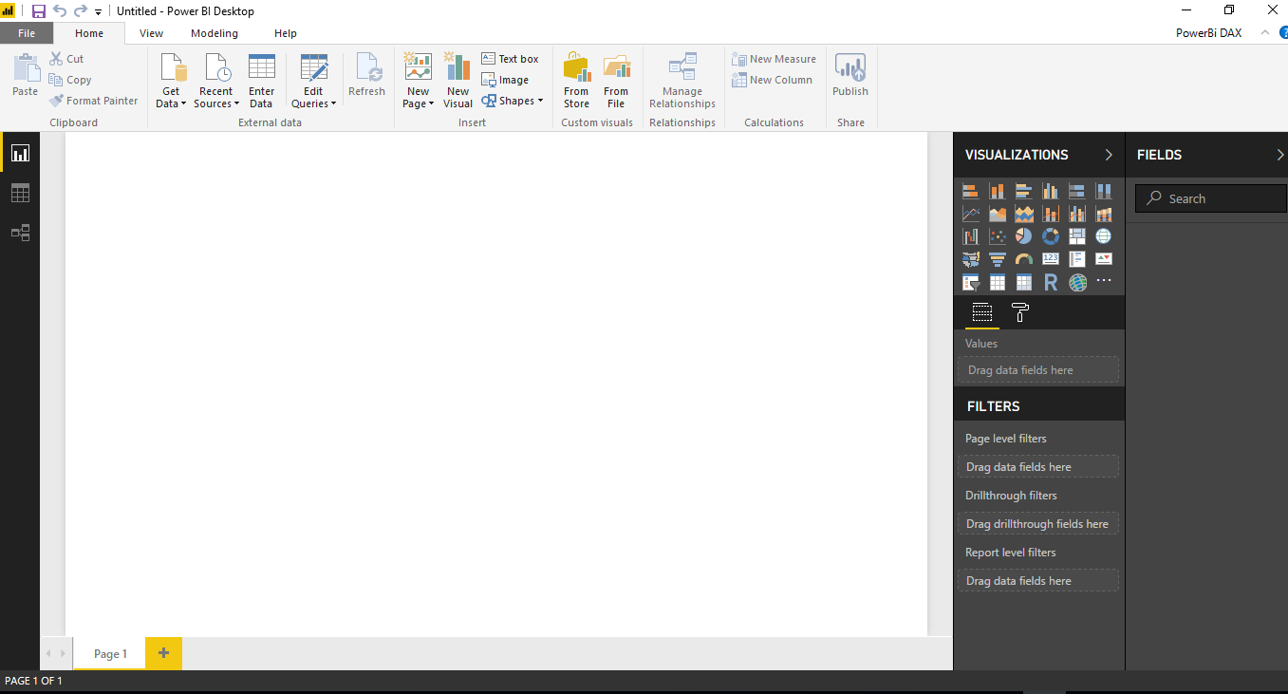
Let’s Create PowerBI from Scratch to Dashboard.
Let’s dig deeper into PowerBI
Report View once PowerBI application is open.

Slide 4
Let’s Create PowerBI from Scratch to Dashboard.
Let’s dig deeper into PowerBI
Report view

Slide 5
Let’s Create PowerBI from Scratch to Dashboard.
Let’s dig deeper into PowerBI
Data view

Slide 6
Let’s Create PowerBI from Scratch to Dashboard.
Let’s dig deeper into PowerBI
Relationship view

Slide 7
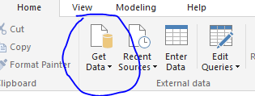
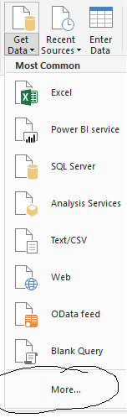
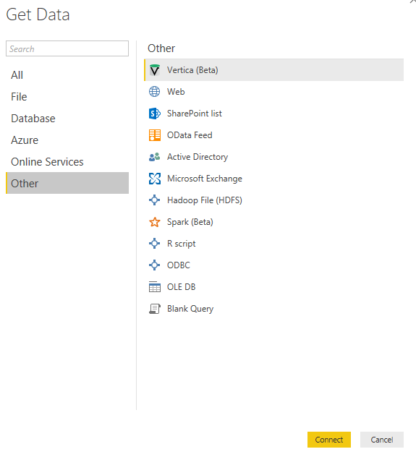
Let’s Create PowerBI from Scratch to Dashboard.
1.We open Getdata
3. Access point connectors
2. More

Slide 8
Let’s Create PowerBI from Scratch to Dashboard.
Using PowerBI Desktop
PowerBI desktop led us to explore data more accurately using the ability to build robust data models. Some of the unique key players involves are these below mentioned factors.
Fields- Values, Filters, Legend, Drill through
Ribbon Charts.
Analytics Pane.
Bookmarks.
Report Themes.
Quick Measures.
Quick Accessibility in PowerBI reports.
Grouping and Binning.
Snap to Grid
Add a column from example.
PowerBI Phone apps.

Slide 9
Let’s Create PowerBI from Scratch to Dashboard.
FIELDS

Slide 10
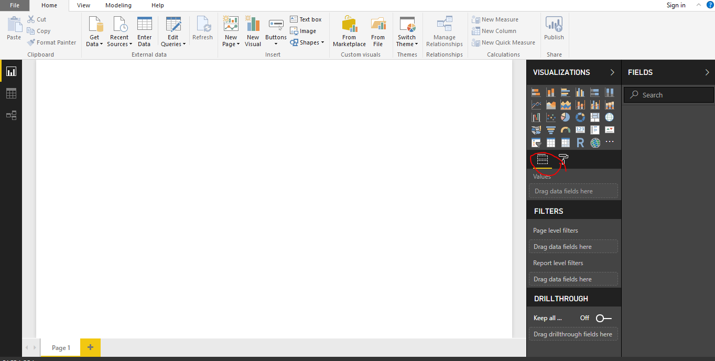
Let’s Create PowerBI from Scratch to Dashboard.

Slide 11
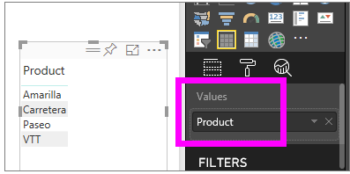
Let’s Create PowerBI from Scratch to Dashboard.
For example if we want to aggregate any data in powerbi dashboard instantly.
We can aggregate a non-numeric field. For example, if we have a product name field, you can add it as a value and then set it to Count, Distinct count, First, or Last.
VALUES WELL
It is typically used for numeric fields. Power BI recognizes that this is a text field, sets the aggregate to Do not summarize, and presents us with a single-column table.
presents us with a single-column table.

Slide 12
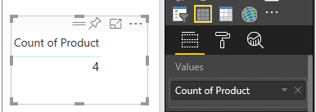
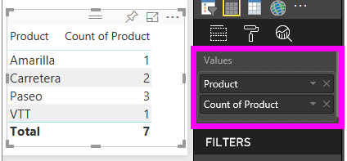
Let’s Create PowerBI from Scratch to Dashboard.
Now, if we change the aggregation from the default Do not summarize to Count (Distinct), Power BI counts the number of different products. In this case, there are 4.
By dragging the same field (in this case Product) into the Values well, and leaving the default aggregation Do not summarize, Power BI breaks down the count by product.

Slide 13
Let’s Create PowerBI from Scratch to Dashboard.
Filters: Filters remove all but the data you want to focus on. Highlighting is not filtering since it does not remove data but instead highlights a subset of the visible data; the unhighlighted data remains visible but dimmed.
Two different Filters those are
Reading view and
Editing view
Reading View | Editing View
In reading view you can interact with any added filters and save the selection | You can add report, page, drillthrough and visual filters.
Cannot add a new filters | When you save the report, the filters are also saved with the report-also in mobile app.
 | People cannot add new filters in it.

Slide 14
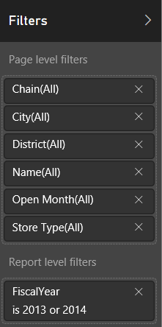
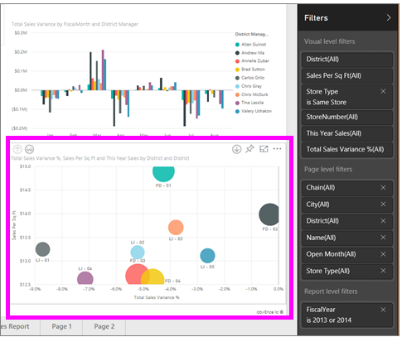
Let’s Create PowerBI from Scratch to Dashboard.
Reading view
In Reading View, explore the data by modifying the existing filters.

Slide 15
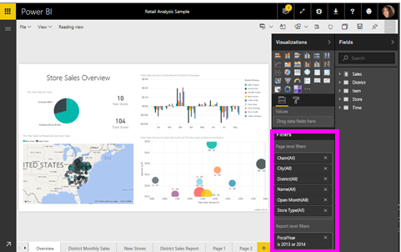
Let’s Create PowerBI from Scratch to Dashboard.
Editing view When you have owner permissions for a report and open it in Editing View, you see that Filters is just one of several editing panes available.

Slide 16
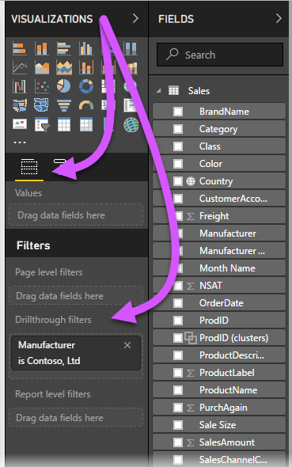
Let’s Create PowerBI from Scratch to Dashboard.
Drillthrough: When you have owner permissions for a report and open it in Editing View, you see that Filters is just one of several editing panes available.
When you have owner permissions for a report and open it in Editing View, you see that Filters is just one of several editing panes available.
on that drillthrough page,
in the Fields section of Visualizations pane,
drag the field about which you want to drillthrough into the Drillthrough filters well.
on that drillthrough page, in the Fields section of Visualizations pane, drag the field about which you want to drillthrough into the Drillthrough filters well.

Slide 17
Let’s Create PowerBI from Scratch to Dashboard.
RIBBON CHART

Slide 18
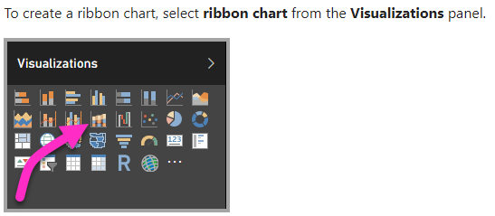
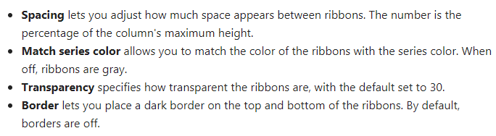
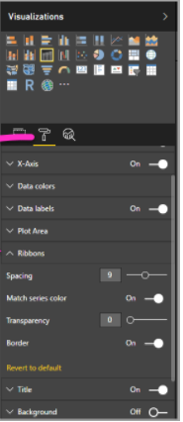
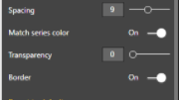
Let’s Create PowerBI from Scratch to Dashboard.
To download custom visualisations use this link.
https://appsource.microsoft.com/en-us/marketplace/apps?product=power-bi-visuals&page=1

Slide 19
Let’s Create PowerBI from Scratch to Dashboard.
ANALYTICS PANE

Slide 20
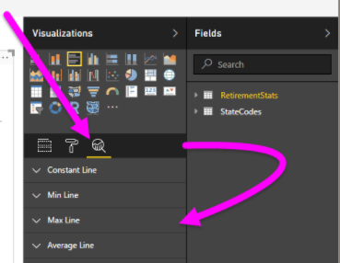
Let’s Create PowerBI from Scratch to Dashboard.

Slide 21
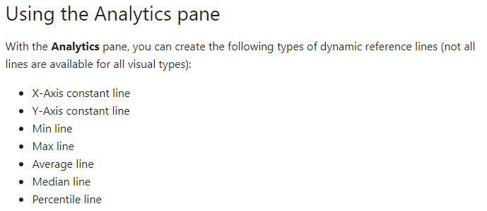
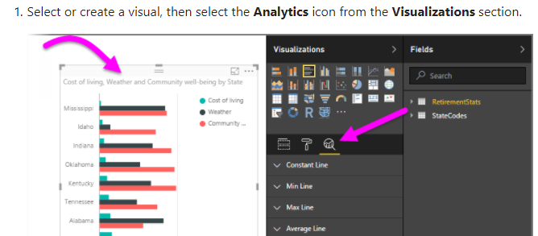
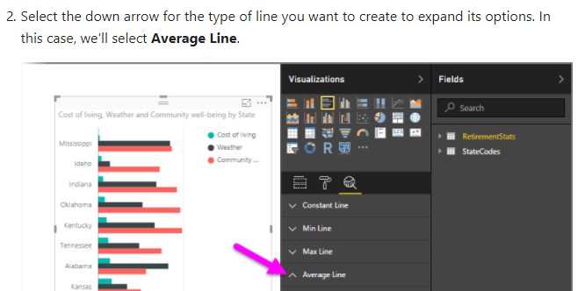
Let’s Create PowerBI from Scratch to Dashboard.

Slide 22
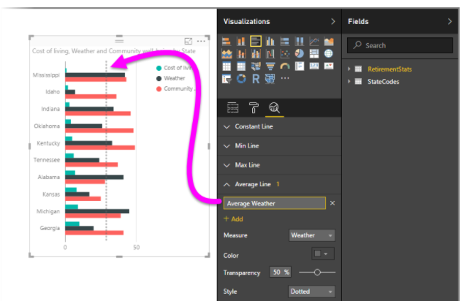
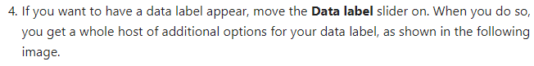
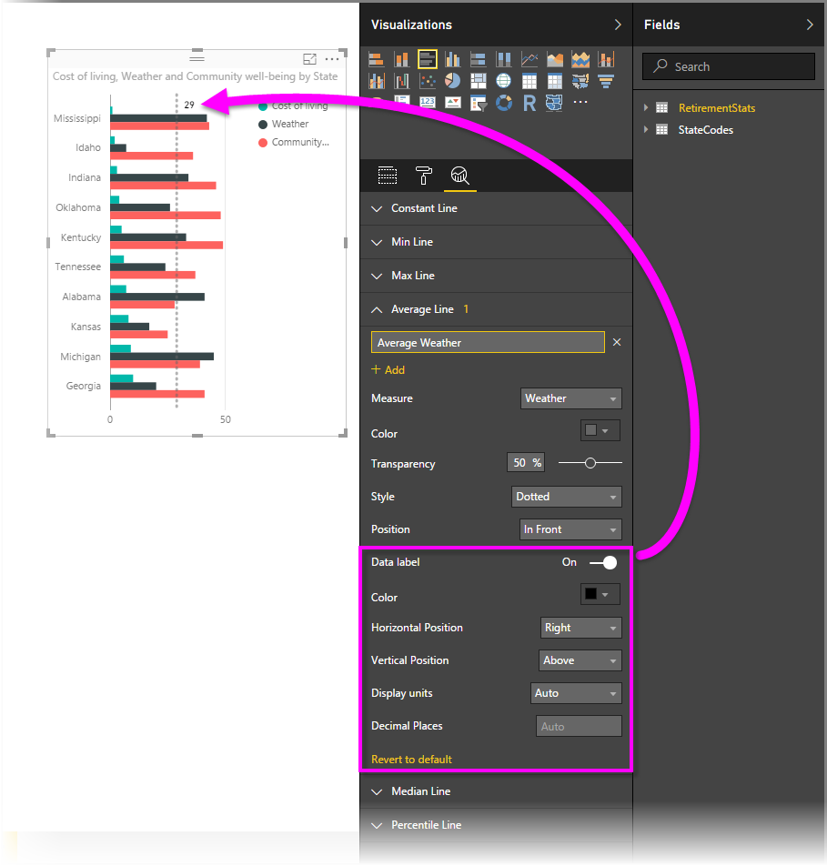
Let’s Create PowerBI from Scratch to Dashboard.

Slide 23
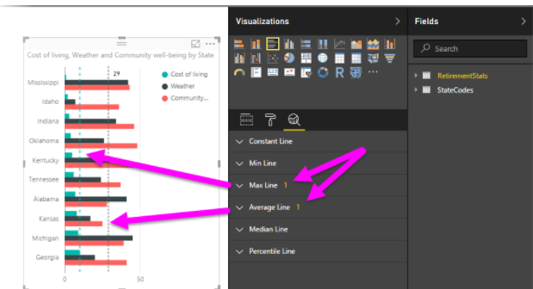
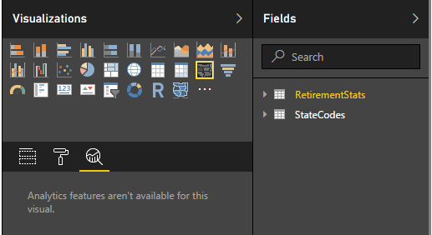
Let’s Create PowerBI from Scratch to Dashboard.
NOTE

Slide 24
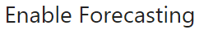
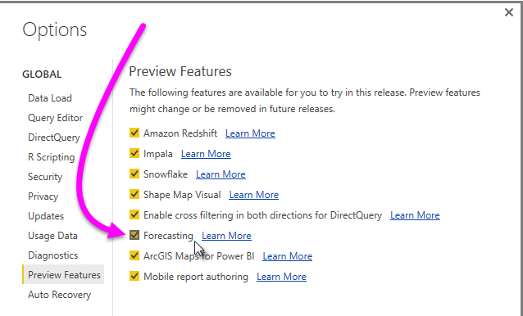
Let’s Create PowerBI from Scratch to Dashboard.

Slide 25
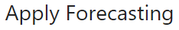
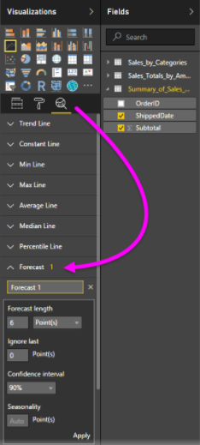
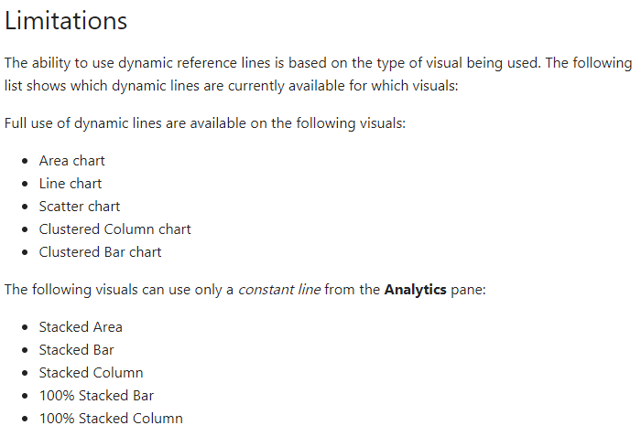
Let’s Create PowerBI from Scratch to Dashboard.

Slide 26
Let’s Create PowerBI from Scratch to Dashboard.
BOOKMARKS

Slide 27
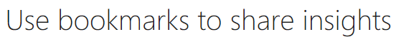
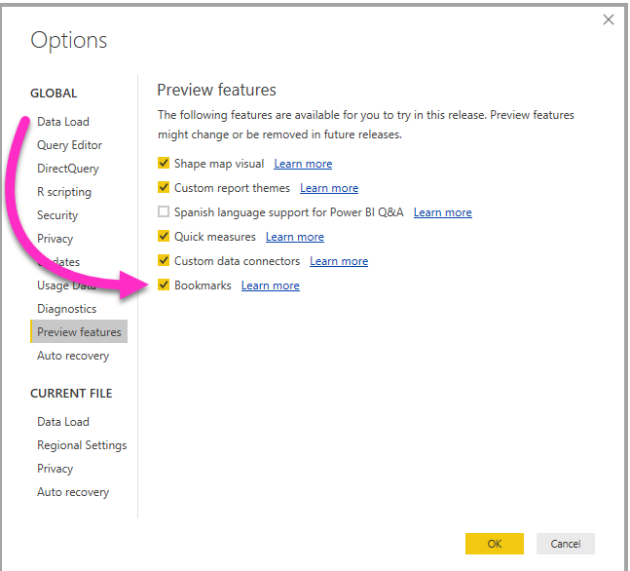
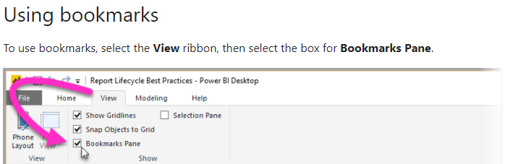
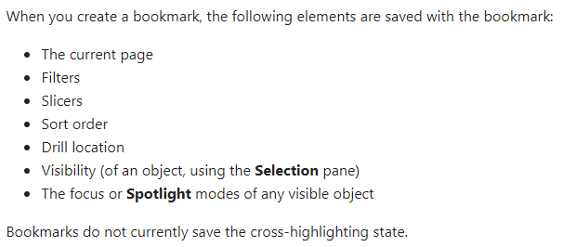
Let’s Create PowerBI from Scratch to Dashboard.

Slide 28
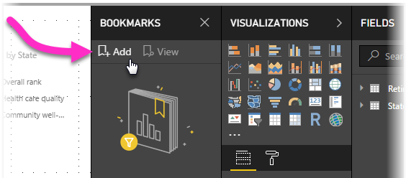
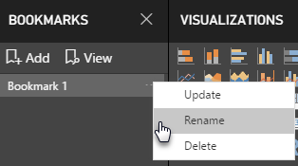
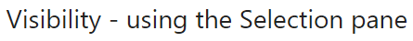
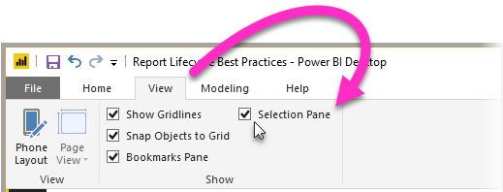
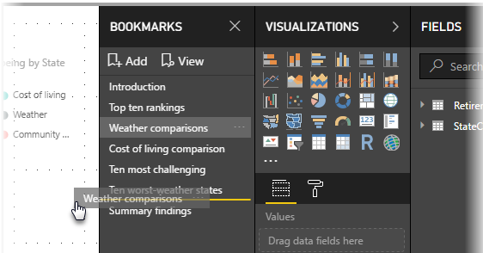
Let’s Create PowerBI from Scratch to Dashboard.
Add Bookmarks
Arranging bookmarks

Slide 29
Let’s Create PowerBI from Scratch to Dashboard.
REPORT THEMES

Slide 30
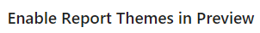
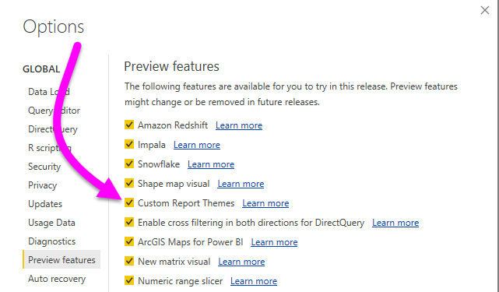
Let’s Create PowerBI from Scratch to Dashboard.

Slide 31
Let’s Create PowerBI from Scratch to Dashboard.
USE QUICK MEASURES
SSAS live connections are supported for this cause.

Slide 32
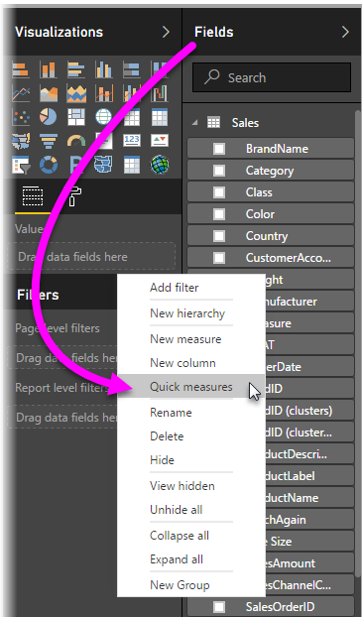
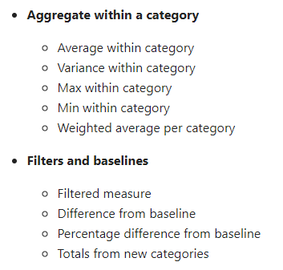
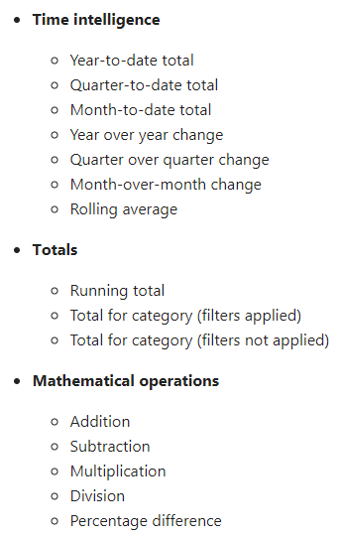
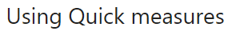
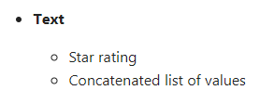
Let’s Create PowerBI from Scratch to Dashboard.

Slide 33
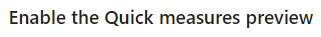
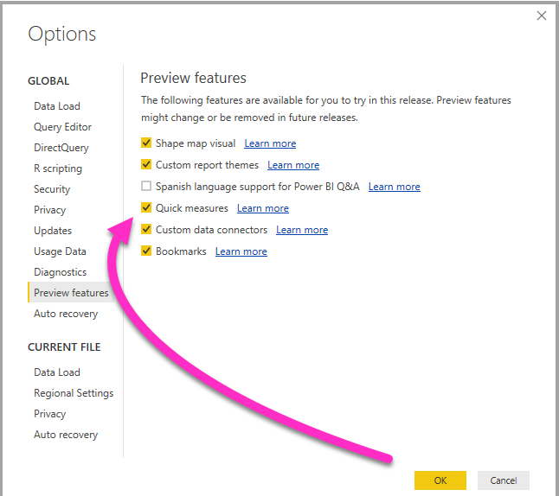
Let’s Create PowerBI from Scratch to Dashboard.

Slide 34
Let’s Create PowerBI from Scratch to Dashboard.
QUICK ACCESSIBILITY WITH POWERBI REPORTS

Slide 35
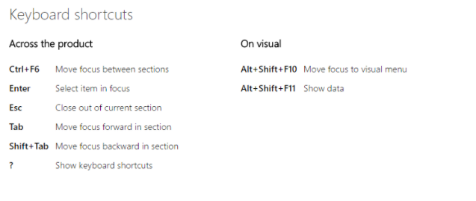
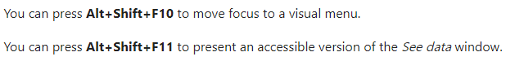
Let’s Create PowerBI from Scratch to Dashboard.

Slide 36



Let’s Create PowerBI from Scratch to Dashboard.

Slide 37

Let’s Create PowerBI from Scratch to Dashboard.
GROUPING

Slide 38




Let’s Create PowerBI from Scratch to Dashboard.

Slide 39
Let’s Create PowerBI from Scratch to Dashboard.
SNAP TO GRID

Slide 40



Let’s Create PowerBI from Scratch to Dashboard.

Slide 41
Let’s Create PowerBI from Scratch to Dashboard.
Adding a column

Slide 42

Let’s Create PowerBI from Scratch to Dashboard.
Simple wise to add column

Slide 43


Let’s Create PowerBI from Scratch to Dashboard.

Slide 44

Let’s Create PowerBI from Scratch to Dashboard.

Slide 45


Let’s Create PowerBI from Scratch to Dashboard.

Slide 46


Let’s Create PowerBI from Scratch to Dashboard.

Slide 47


Let’s Create PowerBI from Scratch to Dashboard.

Slide 48
Let’s Create PowerBI from Scratch to Dashboard.
PowerBI Phone Apps

Slide 49




Let’s Create PowerBI from Scratch to Dashboard.

Slide 50



Slide 51
Downloads
To install PowerBI from Microsoft
https://powerbi.microsoft.com/en-us/desktop/?WT.mc_id=Blog_Desktop_Update
Microsoft One drive
https://onedrive.live.com/?authkey=%21AAgrneBx3oI8Rak&id=B5A9CCD6892588B1%21423&cid=B5A9CCD6892588B1
Microsoft Onedrive data sets
https://onedrive.live.com/?id=7B84B0F2C239489A%212078&cid=7B84B0F2C239489A

Slide 52




Resources
Get Power BI (Free) http://tinyurl.com/hj5hdg6
Power BI Jump Start http://bit.ly/1ktON16
Power BI Getting Started http://bit.ly/1FF88KA
Power BI Team Blog http://bit.ly/1vwbTLG
Power BI Channel 9 http://bit.ly/1a9Q0gv
Power BI https://powerbi.microsoft.com

Slide 53

Thankyou for Coming to PowerBI
Sign up for a free Preview account
Take the Power BI Tour
Notes:
Thanks for taking the time to walk through the main capabilities of Power BI.
If you’re ready to start exploring what Power BI can do for you and your organization, please visit powerbi.com.

